Slide 1
Statistics for Linguistics
Adam J.R. Tallman
2021-06-08

Slide 2
From last class
Confounds
The fork, the pipe, the collider
Generalized linear models

Slide 3
Logistic regression
Logistic regression
Hierarchical models

Slide 4
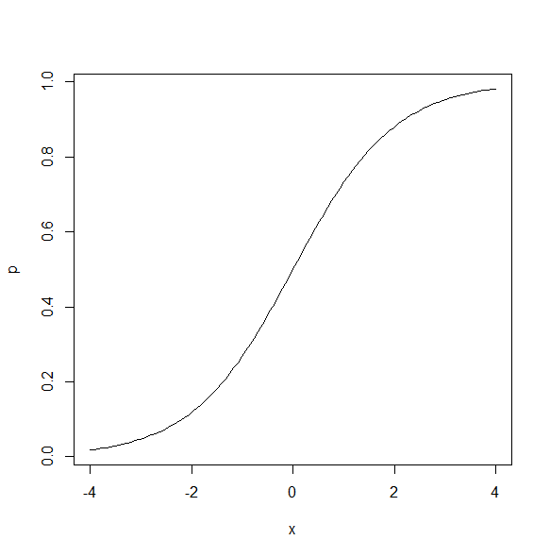
Logistic regression

Slide 5
Logistic regression
Logistic regression is a method for modelling binary data.
The basic ideas can be extended to non-binary data as long as they are organized into levels.
It is typically used when the dependent variable is binary and there is an interest in knowing how a change in x effects the probability that something is y.

Slide 6
Logistic regression (typical uses)
Psycholinguistic experiments where subjects have to give yes or no answers.
Various uses in natural language processing
Predict the risk of developing a specific disease.
Predict probability that someone will vote for a particular political party

Slide 7

Logistic regression
A logistic regression or logit model can be represented with the following equation.

Slide 8
The logistic function
But let’s back up a bit to see why this makes sense and what this means…

Slide 9
Bernouilli distribution
Bernouilli distribution is a discrete distribution with two possible outcomes.
We want to account for the distribution of y.
You can model it with rbinom()
data <- rbinom(20, 1, 0.5)
data

Slide 10
Logistic function
The important point about log odds ratios as that they take any numbers and transform them to a number from 0 to 1 along a sigmoid shape.
Why is this good?
Because we are interested in modelling a a binary outcome, 0 or 1, and we want to have a function that translates the effect of predictors into that scale for y.

Slide 11
Logistic function
That’s basically what the following will do.
Any value of x will be transformed into a number that varies from 0 to 1 with ceiling effects.

Slide 12
Logistic regression
Y Is bounded to 0 or 1
The relationship between x and y has a ceiling effect (like logarithms)
Let’s run a simulation model to get the feel for it.

Slide 13
Two causative constructions in Dutch
Doen relates to direct causation
Laten relates to indirect causation
(1) Hij deed me denken aan mijn vader
He did me think at my father
‘He reminded me of my father.’
(2) Ik liet hem mijn huis schilderen
I let him my house Paint
‘I had him paint my house.’

Slide 14
Interpreting logistic regression cofficients
It is hard to interpret logistic regression coefficients because the relationship is non-linear.
The intercept is interpreted assuming 0 for other predictors
But sometimes 0 is not interesting
Alternatively we can interpret the intercept at the center point
Rather than consider a discrete change in x we can compute the derivative of the logistic curve at the central value (where the relationship is steepest.
You get this by dividng the coefficient by 4.

Slide 15
Multilevel models

Slide 16
Multilevel regression (varying intercept)
Multilevel regression is an extension of regression modelling to cases where the data are grouped.
When we have been talking about statistical models we have modelled the errors, the predictors and the outcomes as random variables.
They are sampled from some probability distribution.

Slide 17
Multilevel regression and random variables
Here’s a normal regression model
We can put in i to reflect the fact that our model makes predictions about specific data points: for a given x you get a specific y with a specific error e. Everything we can put with an i subscript is a random variable

Slide 18
Multilevel regression and random variables
What do we mean by random variable?
Some distribution with a mean and standard deviation.

Slide 19
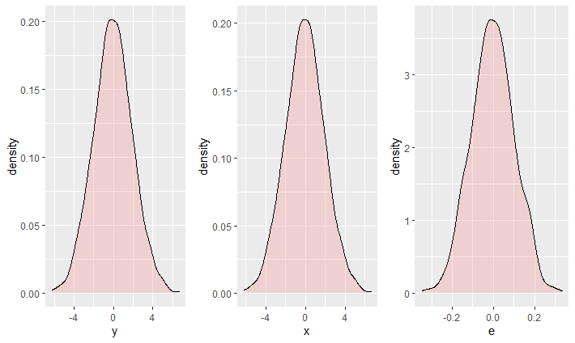
Multilevel regression and random variables
What do we mean by random variable?
Some distribution with a mean and standard deviation.
But the coefficients alpha and beta are fixed.

Slide 20
Multilevel regression and random variables
What do we mean by random variable?
Some distribution with a mean and standard deviation.
But the coefficients alpha and beta are fixed numbers

Slide 21
Multilevel regression and random variables
But let’s say you are running the model repeatedly over different groups within a population. Do you expect the coefficients to be the same?

Slide 22
Multilevel regression and random variables
You can build a model where the intercept is also a random variable reflecting the variation between groups, where j is the group.
Or a model where the slope is also a random variable.
Or a model where both the intercept and the slope are random variables.

Slide 23
Multilevel regression and random variables
In such cases you have a random variable for the effects of your model.
That’s why multilevel models are sometimes called ‘random effects models’

Slide 24
Multilevel regression and random variables
In such cases you have a random variable for the effects of your model.
That’s why multilevel models are sometimes called ‘random effects models’
…

Slide 25
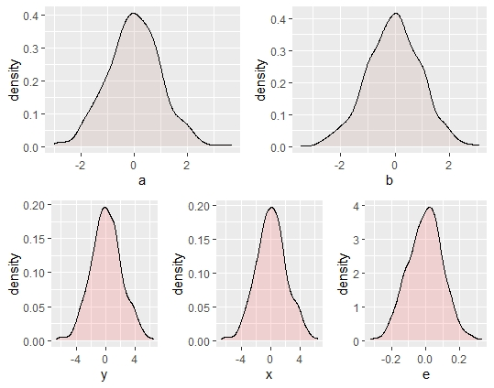
Multilevel regression and random variables
In such cases you have a random variable for the effects of your model.
That’s why multilevel models are sometimes called ‘random effects models’
…

Slide 26
Multilevel regression and random variables
In such cases you have a random variable for the effects of your model.
That’s why multilevel models are sometimes called ‘random effects models’
…

Slide 27
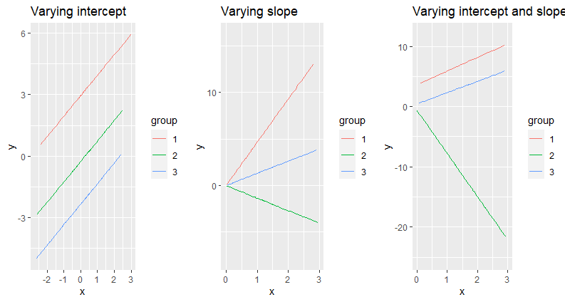
Multilevel regression and random variables

Slide 28
Why?
Why would we ever do this?
Why no just have lots of separate models for each group?

Slide 29
Schools
Imagine trying to assess the effectiveness of some new education curriculum of teaching style.
You have a treatment group and a control group and then you assess the students’ results.

Slide 30
Schools
But you know that there will be variation between schools.
Some schools won’t be able to effectively administer the training/treatment because they have less resources.
Furthermore, you have variation between schools with respect to how many students participated.
Schools vary in terms of their culture, socioeconomic conditions teachers, size, quality and style of education.
Yet, the students are all from the same population.

Slide 31
Schools
You have a measurement for aptitude y and you have a treatment variable (trained or not trained) x.
What do you do with the schools variable?
Complete pool
Run a regression ignoring the variation between schools
No pooling
Run a regression for each school
Run a regression with school as a factor

Slide 32
Complete pooling
Complete pooling has the obvious danger of ignoring the variation between schools.
If one school has more data points it could be an outlier with respect to the effects, but overwhelm the data across cases.
The results might be biased towards with more data points.

Slide 33
No pooling
No pooling could tend to exaggerate the variation between schools.
For schools that do not have very many data points, there is a higher likelihood of variation simply appearing by chance.
Think of the law of large numbers

Slide 34
Partial pooling
Multilevel modelling basically compromises between complete pooling and no pooling.
‘Multilevel modeling partially pools the group-level parameters α_{j} toward their mean μ_{α}. There is more pooling when the group-level standard deviation σ_{α} is small, and more smoothing for groups with fewer observations.’
Gelman & Hill (2009: 258)

Slide 35
Partial pooling
Partial pooling results in shrinkage of variance in the coefficients of each group towards the overall mean as a function of their in-group sample size (n_{j})
Shrinkage is less as your in-group sample size is larger.
Partial pooling towards the mean.

Slide 36
Multilevel models
Classical regression models can be viewed as a special case of multilevel models
As σ_{α}→ 0 the model is more like a complete pooling model.
As σ_{α}→ ∞ the model is more like a no-pooling model.

Slide 37
Multilevel models
Extension of regression to grouped data
Varying slope model
Varying intercept model
Individual vs. group level models
Indicator variables
Fixed or random effects
Complete pooling vs. no pooling
Multilevel weighted average
Classical regressions as a special case

Slide 38
Odds,log odds, odds ratios and log odds ratios
Odds: simple ration of the probability of one event to the probability of another event (frequency of a / frequency b) are the odds of a over b.
Log odds: Logarithmically transformed odds.
Odds ratio: ratio of two odds.
Log odds ratio: Logarithmically transformed log odds.

